Slide 1
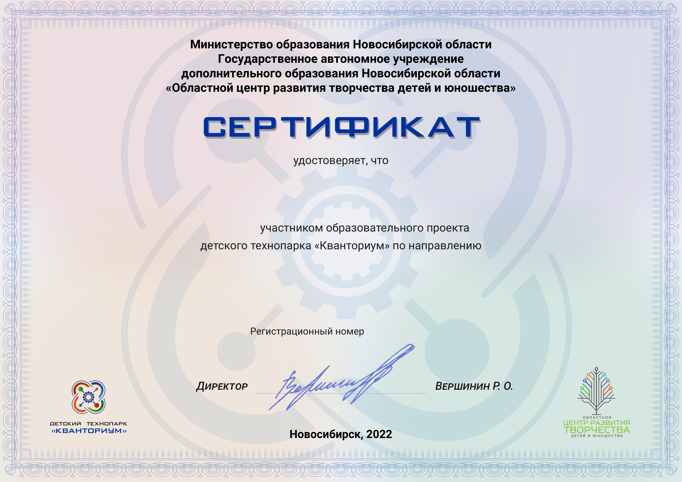
name
sex
direction
level
number

